Slide 1
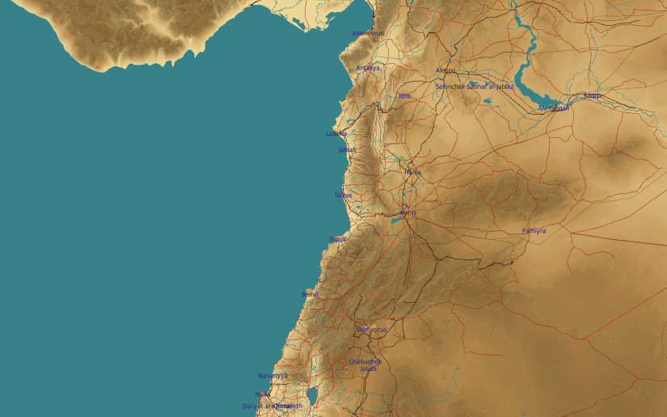
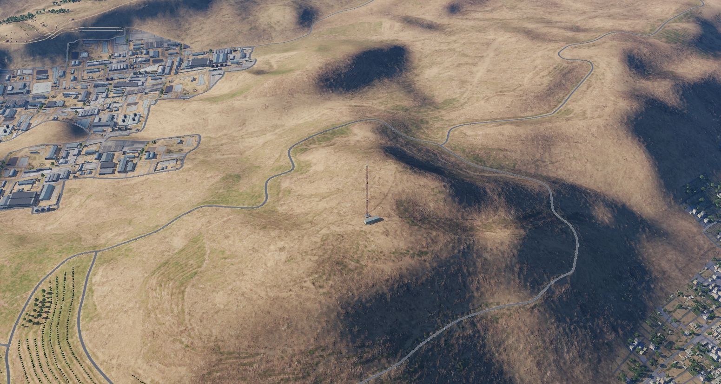
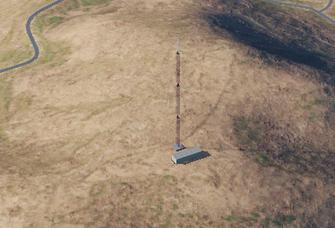
OPARTGT034 Damascus Radio Tower
N
Equipment Hall
34
Mast
DESCRIPTION OF THE DESIRED POINTS OF IMPACT WITH WPN TYPE:
OPARTGT034A – Damascus Radio Mast
DPI 1 N33 32.021 E036 16.383/3714ft/(1000 Ibs bomb)
Residential areas NW and SE of the facility within 1KM.

